Slide 1

Codergirl - JavaScript
Class 6
September 2, 2020

Slide 2
Agenda
Studio recap – 6:00 pm
Lecture – 6:20 pm
Exercises – 7pm

Slide 3
Functions
function myFunction(par1, par2) {
// function body and return statement
}
function printNames(names) {
for (let i = 0; i < names.length; i++) { console.log(names[i]);
}
}

Slide 4
Studio review – part 1
Reverse the order of elements in an array
Reverse the sequence of letters/numbers in each of the element in the array
['apple', 'potato', 'Capitalized Words'] | ['sdroW dezilatipaC', 'otatop', 'elppa']
[123, 8897, 42, 1138, 8675309] | [9035768, 8311, 24, 7988, 321]
['hello', 'world', 123, 'orange'] | ['egnaro', 321, 'dlrow', 'olleh']

Slide 5
Functions - variables
Notes:
https://education.launchcode.org/
intro-to-professional-web-dev/chapters/more-on-functions/functions-as-values.html
Datatype of a function is function. It can be assigned to a variable, just like strings and numbers, and can be passed around, making them highly usable.

Slide 6
Anonymous fn
Notes:
https://education.launchcode.org/intro-to-professional-web-dev/chapters/more-on-functions/anonymous-functions.html

Slide 7
fn as Argument
Array map example – very useful
setTimeout (built-in method)
Notes:
https://education.launchcode.org/intro-to-professional-web-dev/chapters/more-on-functions/passing-functions.html
Since functions are data, they can be passed around.
The array method map allows for every element in an array to be mapped or translated, using a given function. Here's how to use it:
The built-in function setTimeout allows a programmer to pass a function, specifying that it should be called at a later point in time. Its basic syntax is:
You can also write a function that expects to receive a function.

Slide 8
recursion
function calling itself (clever)
reduce problem– base case (true) => end
alter data/variables/condition to move closer to base case
Notes:
https://education.launchcode.org/intro-to-professional-web-dev/chapters/more-on-functions/recursion.html

Slide 9
Code examples and
exercises
The following routes owned by Team Explorer
https://mycrop.bayer.com/myaccount/order-and-quote-details
https://mycrop.bayer.com/myaccount/warehouse-inventory
https://mycrop.bayer.com/myaccount/fieldcheckupseries
are any of these routes owned by 301?6:11
These routes owned by us
https://mycrop.bayer.com/myaccount/dashboard
https://mycrop.bayer.com/myaccount/farmers
https://mycrop.bayer.com/myaccount/farmer-details
https://mycrop.bayer.com/myaccount/businessplan
https://mycrop.bayer.com/myaccount/orders
https://mycrop.bayer.com/myaccount/order-details
https://mycrop.bayer.com/myaccount/inventory
Gary Barmak 6:13 PM
Could you please go to Ocelot and delete /myaccount for mycrop?
New
Chetna Aggarwal 6:24 PM
I don’t think we can do that since myaccount has stuff in prod.
6:25
Let me check with my team though
Gary Barmak 6:25 PM
sure
Notes:
https://education.launchcode.org/intro-to-professional-web-dev/chapters/more-on-functions/exercises.html
Base case example

Slide 10
Questions?

Slide 11
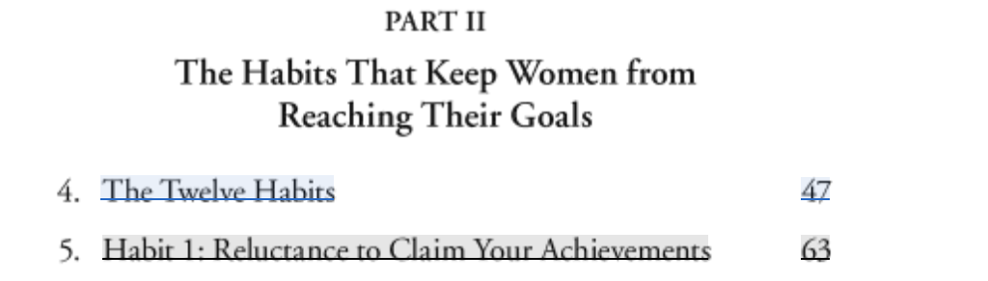
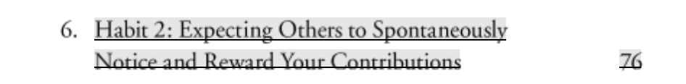
https://www.amazon.com/How-Women-Rise-Holding-Promotion/dp/0316440124

Slide 12
Studio time!
Notes:
https://education.launchcode.org/intro-to-professional-web-dev/chapters/more-on-functions/studio.html

